Slide 1




REMOTE SENSING IN AGRICULTURE
Lecture 3: Principles & Applications
AGE 418
Dr. Kadeghe Fue

Slide 2




Lecture Roadmap
Principles
Applications
Definition & The Physics
Sensor Types (Active vs. Passive)
Electromagnetic Spectrum (EM)
Platforms (Satellites vs. UAVs)
Spectral Signatures of Crops
Vegetation Indices (NDVI)

Slide 3
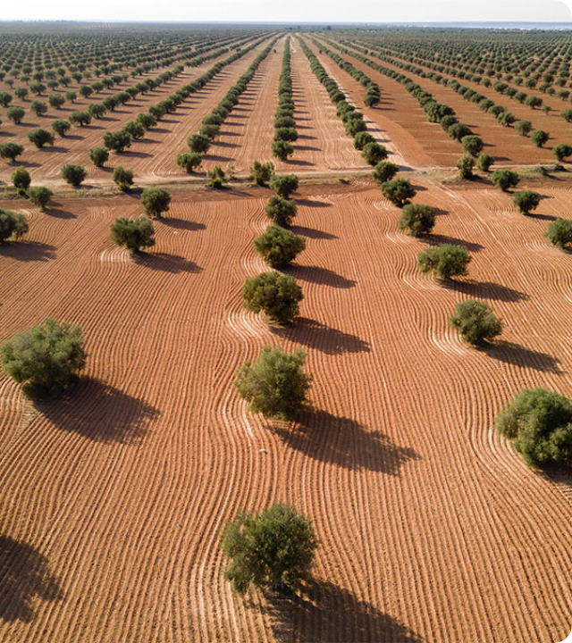
What is Remote Sensing?
The science of obtaining information about an object or area from a distance, typically from aircraft or satellites.
In Agriculture: It is the non-contact measurement of radiation reflected or emitted from agricultural fields.
Key Concept: Interaction of light with plant matter.

Slide 4

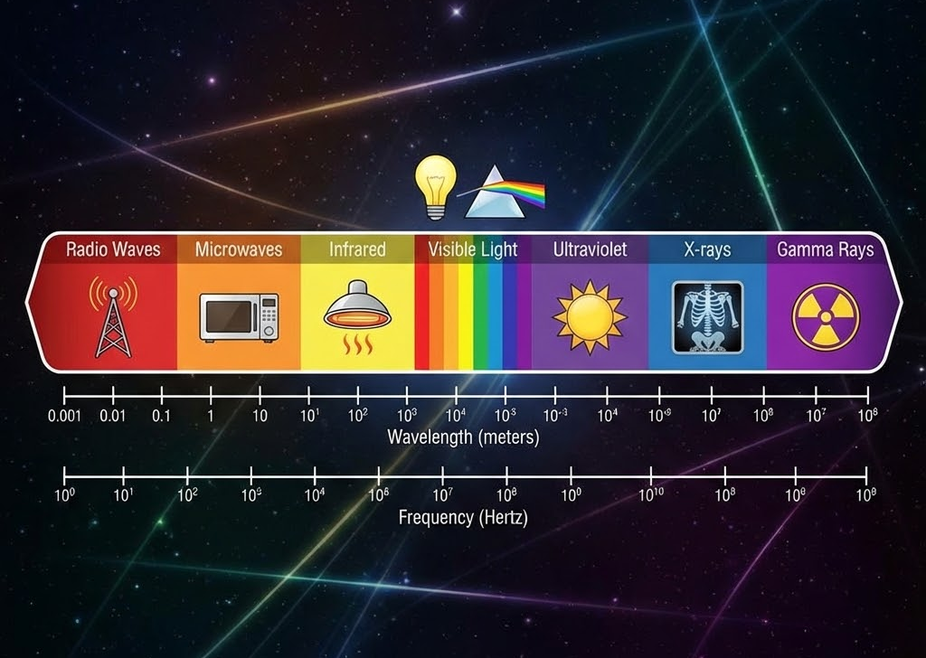
The Electromagnetic Spectrum
Plants interact differently with different wavelengths:
Visible (RGB): 400-700nm. Absorbed by chlorophyll for photosynthesis.
Near Infrared (NIR): 700-1300nm. Strongly reflected by healthy cell structures (spongy mesophyll).
Shortwave Infrared (SWIR): Sensitive to water content.

Slide 5
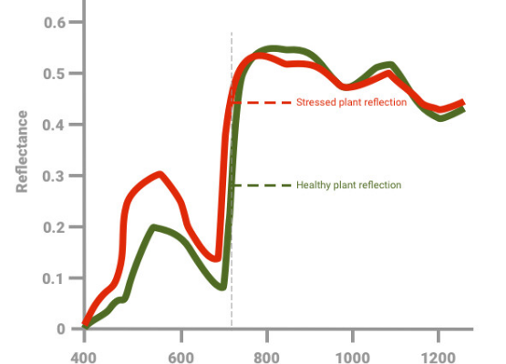
The "Fingerprint" of Crops
Healthy vs. Stressed
Every surface has a unique spectral signature.
Healthy Vegetation: Low Red reflectance (high absorption), Very High NIR reflectance.
Stressed/Dry Vegetation: Higher Red reflectance (chlorophyll breakdown), Lower NIR reflectance (cell collapse).

Slide 6

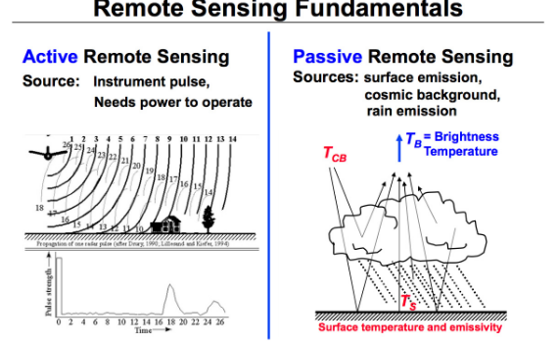
Passive vs. Active Sensors
Passive | Active
Uses Sunlight as energy source. | Emits its own energy source.
Cameras, Multi-spectral. | Radar (SAR), LiDAR.
Con: Cannot work at night or through clouds. | Pro: Works day/night and penetrates clouds.

Slide 7
Satellite Platforms
Sentinel-2 & Landsat
The workhorses of precision agriculture.
Temporal Resolution: Revisit time (e.g., Sentinel-2 is 5 days).
Spatial Resolution: Pixel size (e.g., 10m x 10m).
Pros: Free data, covers huge areas.
Cons: Cloud cover issues, lower resolution than drones.

Slide 8
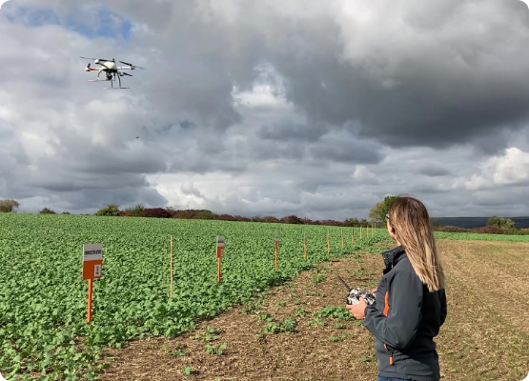
UAV / Drone Platforms
Unmanned Aerial Vehicles (UAVs) offer "User-Controlled" remote sensing.
Ultra-High Resolution: Centimeter-level pixels.
On-Demand: Fly whenever you want (under clouds).
Flexibility: Swap sensors (RGB, Multispectral, Thermal).
Challenge: Battery life and data processing volume.

Slide 9



Vegetation Indices: NDVI
Normalized Difference Vegetation Index
The most common metric for crop health.
High Values (> 0.6)
Low Values (< 0.2)
Dense, healthy vegetation (High NIR, Low Red).
Soil, water, or stressed/dead plants.

Slide 10
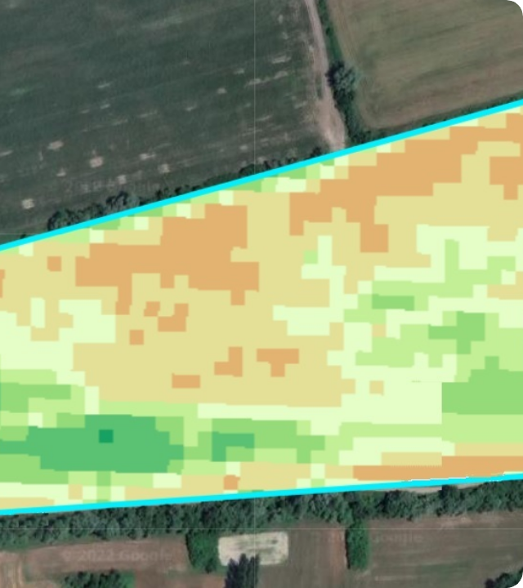
Applications in PA
Yield Prediction: Correlating peak season NDVI with final harvest.
Stress Detection: Identifying water stress (Thermal IR) before visible wilting.
Variable Rate Application: Generating Nitrogen prescription maps based on biomass.
Disease Monitoring: Detecting patches of blight or pest infestation.

Slide 11

Lecture Summary
Physics
Sensors
Data
Plants reflect NIR and absorb Red light. This unique signature is the basis of RS.
Passive sensors (Cameras) need sun; Active sensors (Radar) make their own energy.
Indices like NDVI quantify health, enabling data-driven decisions.
Next Class: Lecture 4 - Proximal Soil Sensors

Slide 12

Questions?
Dr. Kadeghe Fue | AGE 418
Sokoine University of Agriculture

